Slide 1
CSE214 – Analysis of Algorithms PhD Furkan Gözükara, Toros University https://github.com/FurkanGozukara/CSE214_2018
Lecture 6
Linear Sorting
Based on Andrew Davison’s Lecture Notes

Slide 2
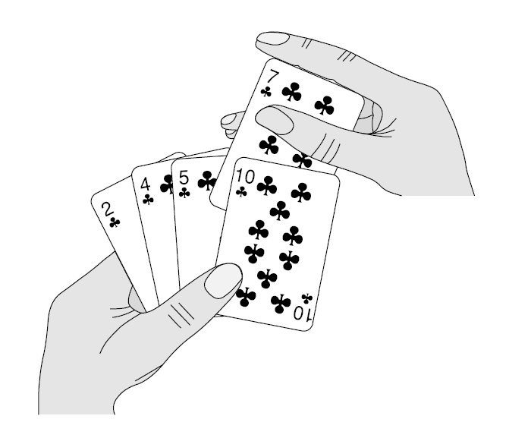
Sorting So Far
Insertion sort:
Easy to code
Fast on small inputs (less than ~50 elements)
Fast on nearly-sorted inputs
O(n²) worst case
O(n²) average (equally-likely inputs) case
O(n²) reverse-sorted case

Slide 3
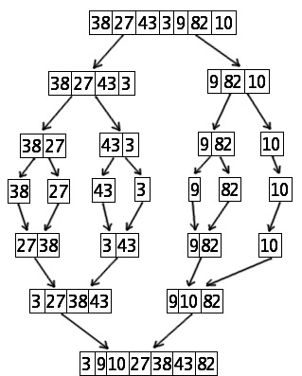
Sorting So Far
Merge sort:
Divide-and-conquer:
Split array in half
Recursively sort subarrays
Linear-time merge step
O(n lg n) worst case
Doesn’t sort in place

Slide 4
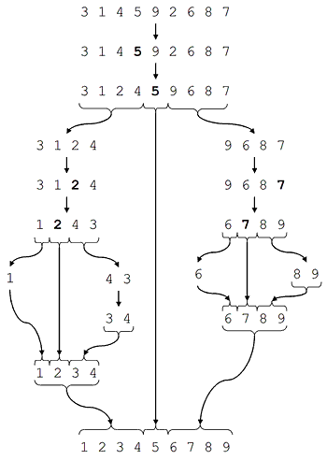
Sorting So Far
Quicksort:
Divide-and-conquer:
Partition array into two subarrays, recursively sort
All of 1st subarray < all of 2nd subarray
No merge step needed!
O(n lg n) average case
Fast in practice
O(n²) worst case
for sorted input
this is avoided by using a randomized pivot

Slide 5
How Fast Can We Sort?
Selection Sort, Bubble Sort, Insertion Sort:
Heap Sort, Merge sort:
Quicksort:
What is common to all these algorithms?
Make comparisons between input elements
a_{i} < a_{j}, a_{i} ≤ a_{j}, a_{i} = a_{j}, a_{i} ≥ a_{j}, or a_{i} > a_{j}
O(n²)
O(nlgn)
O(nlgn) - average

Slide 6
How Fast Can We Sort?
All these sorting algorithms are comparison sorts
gain ordering information about a sequence using the comparison of two elements (=, <, >)
Theorem: all comparison sorts are O(n lg n) or slower
The best speed for sorting is O(n)
we must look at all the data
for that we must use sorting algorithms which don't require comparisons of all the data

Slide 7
Can we do better?
Linear sorting algorithms
Counting Sort
Radix Sort
Bucket sort
Make certain assumptions about the data
Linear sorts are NOT “comparison sorts”

Slide 8
Non-Comparison Based Sorting
Many times we have restrictions on our keys
Deck of cards: Ace->King and four suites
Social Security Numbers
Employee ID’s
We will examine three algorithms which under certain conditions can run in O(n) time.
Counting sort
Radix sort
Bucket sort

Slide 9
Counting Sort
Does no comparisons between the array elements!
This depends on an assumption about the numbers being sorted
We assume numbers are integers in the range 1.. k
running time depends on k, so might be slower than comparison sorts
The algorithm:
Input: A[1 .. n], where A[j] ∈ {1, 2, 3, …, k}
Output: B[1 .. n], sorted (notice: not sorting in place)
Also: Array C[1 .. k] for auxiliary storage

Slide 10
Pseudocode
CountingSort(int[] A, int[] B, int k) // sort A into B; elems range: 1..k
for i ← 1 to k // initialization count occurences array
do C[i] ←0
for j ← 1 to n // counting
do C[A[j]] ← C[A[j]] + 1 // C[i] = |{key == i}|
for i ← 2 to k // summing
do C[i] ←C[i] + C[i–1] // C[i] = |{key ≤ i}|
for j ← n down to 1 // create output array (distribution)
do B[ C[ A[j] ] ] ← A[j]
C[ A[j] ] ← C[ A[j] ] –1

Slide 11
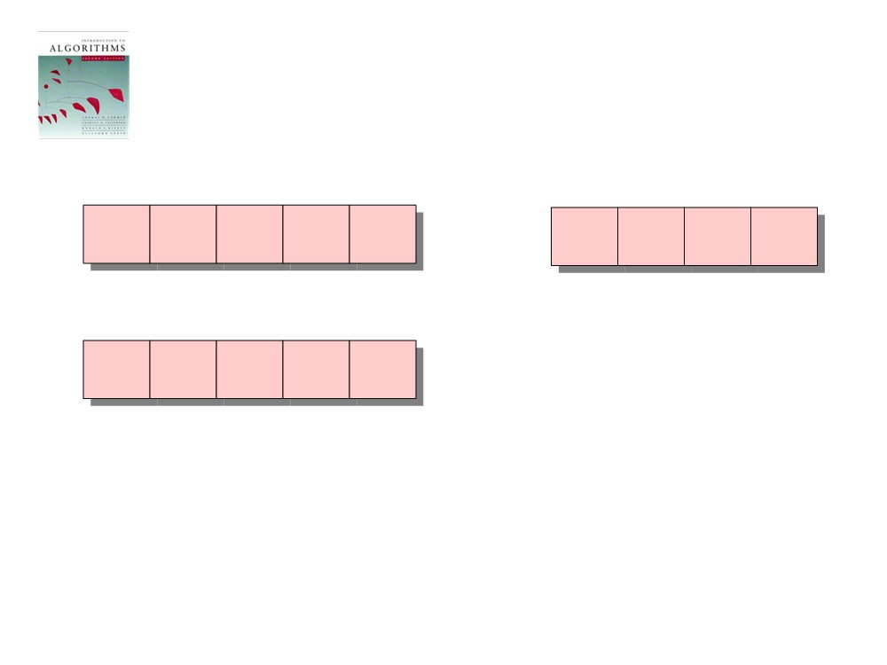
Counting-sort example
1
2
3
4
5
1
2
3
4
A:
4
1
3
4
3
C:
B:
n size
k size

Slide 12
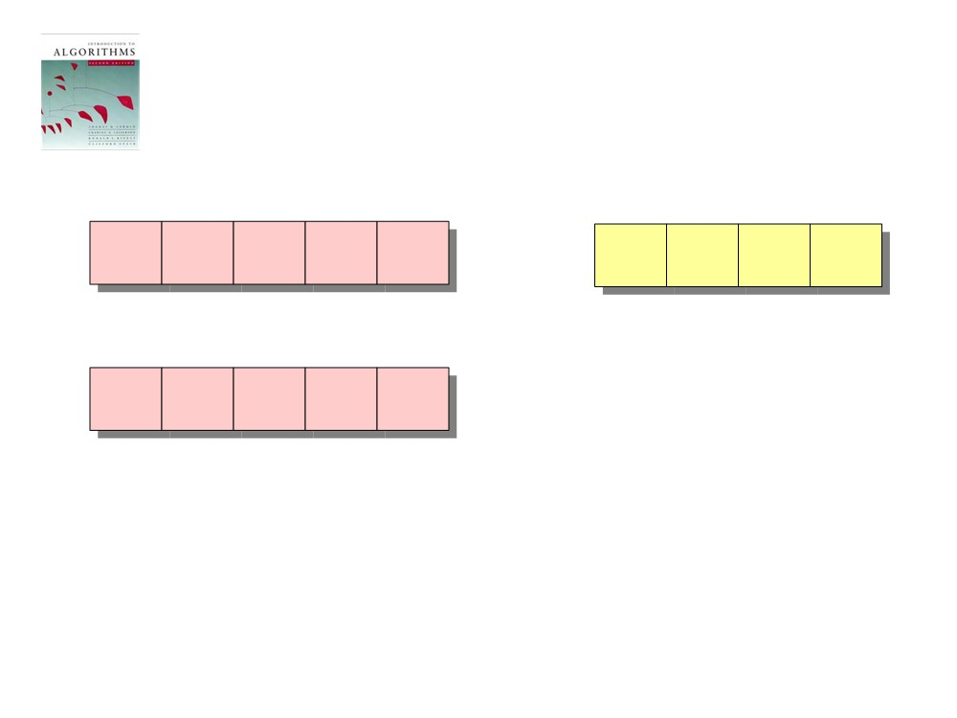
Loop 1
1
2
3
4
5
1
2
3
4
A:
4
1
3
4
3
C:
0
0
0
0
B:
for i ← 1 to k
do C[i] ← 0

Slide 13
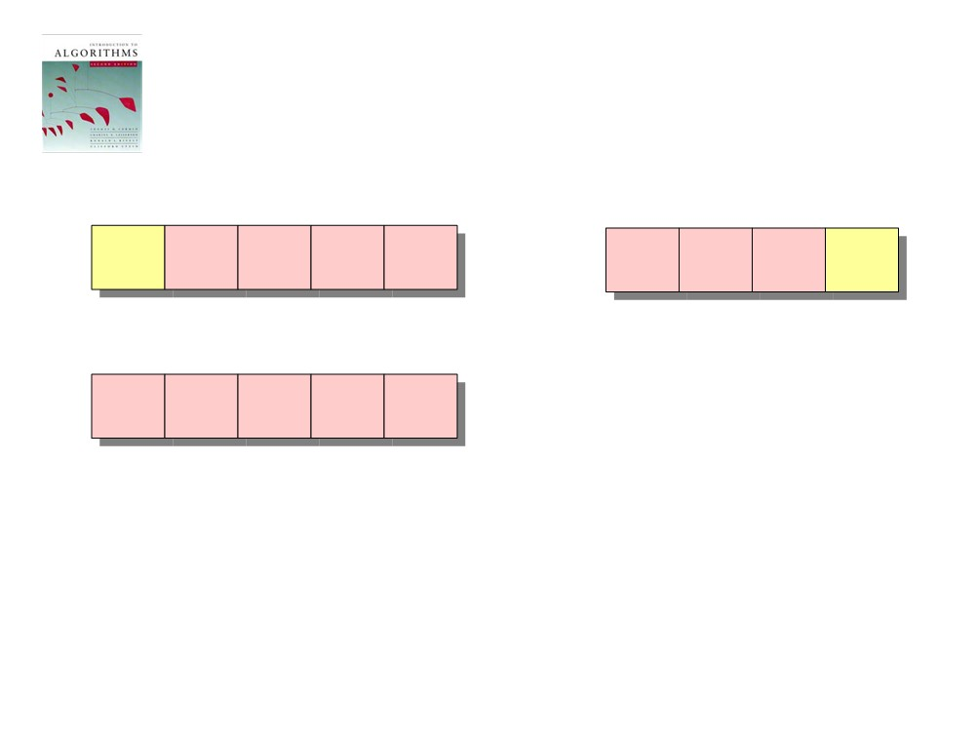
Loop 2
1
2
3
4
5
1
2
3
4
A:
4
1
3
4
3
C:
0
0
0
1
B:
for j ← 1 to n
do C[A[ j]] ← C[A[ j]] + 1
// C[i] == |{key = i}|

Slide 14
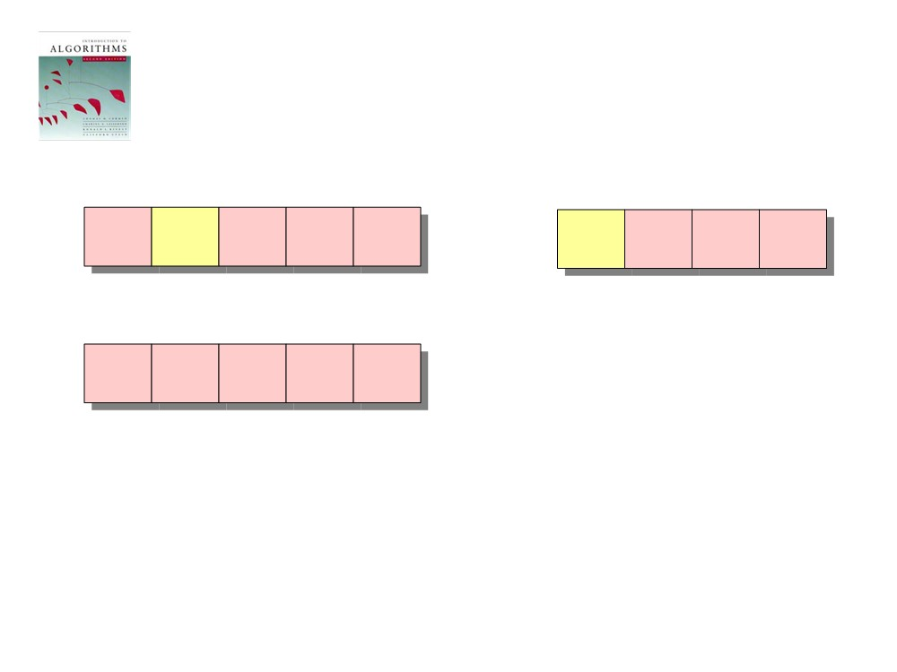
Loop 2
1
2
3
4
5
1
2
3
4
A:
4
1
3
4
3
C:
1
0
0
1
B:
for j ← 1 to n
do C[A[ j]] ← C[A[ j]] + 1
// C[i] = |{key == i}|

Slide 15
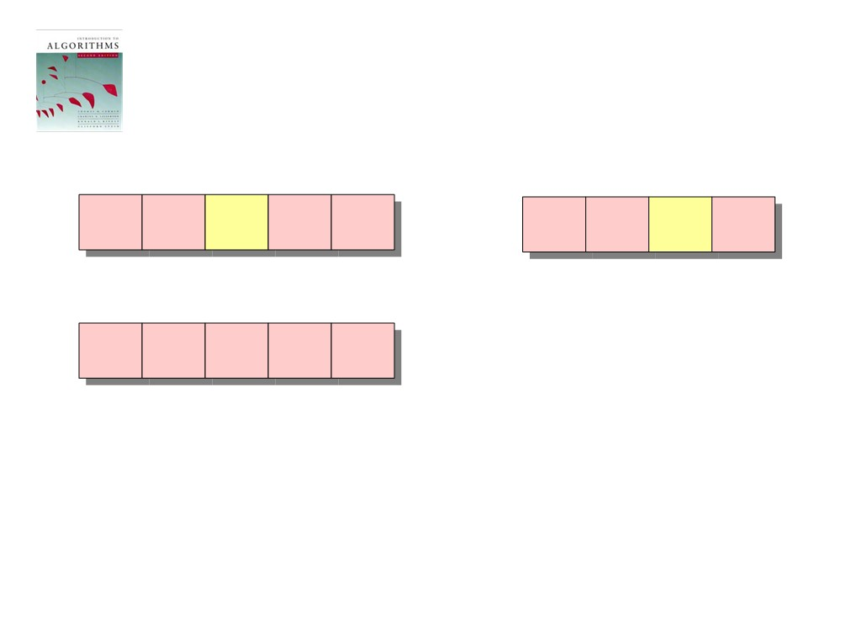
Loop 2
1
2
3
4
5
1
2
3
4
A:
4
1
3
4
3
C:
1
0
1
1
B:
for j ← 1 to n
do C[A[ j]] ← C[A[ j]] + 1
// C[i] = |{key == i}|

Slide 16
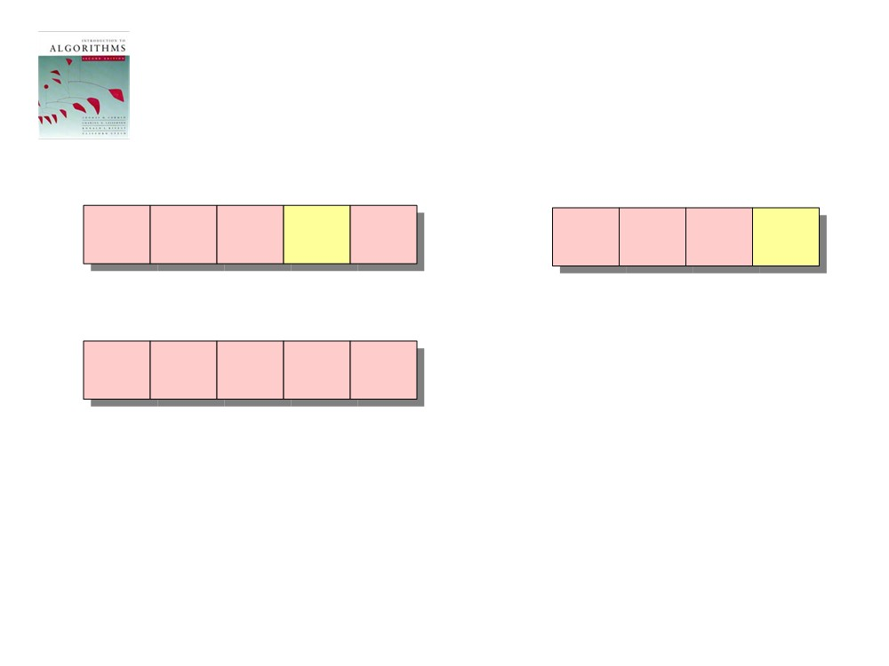
Loop 2
1
2
3
4
5
1
2
3
4
A:
4
1
3
4
3
C:
1
0
1
2
B:
for j ← 1 to n
do C[A[ j]] ← C[A[ j]] + 1
// C[i] = |{key == i}|

Slide 17
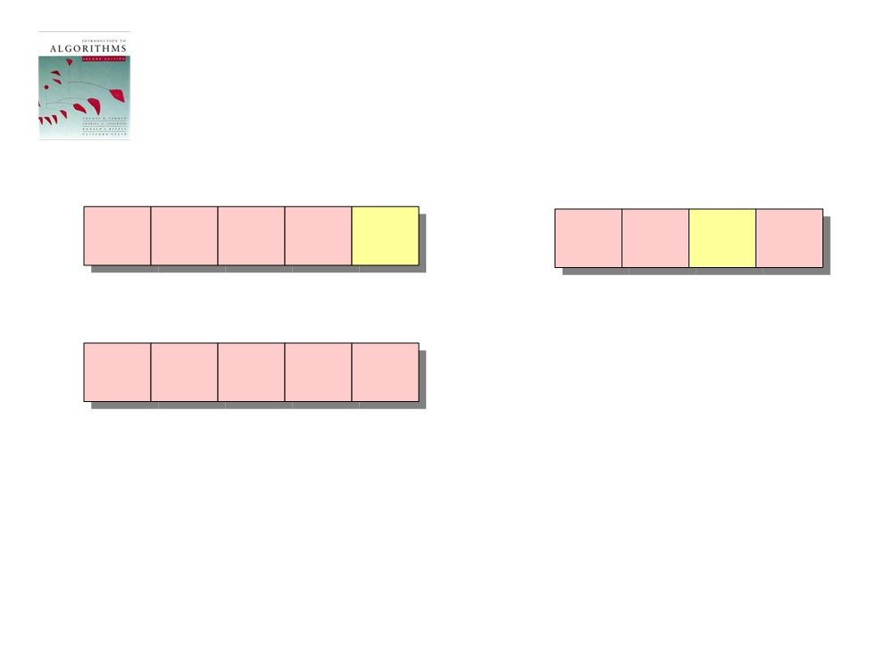
Loop 2
C is the number
of data occurences
1
2
3
4
5
1
2
3
4
A:
4
1
3
4
3
C:
1
0
2
2
B:
for j ← 1 to n
do C[A[ j]] ← C[A[ j]] + 1
// C[i] = |{key == i}|

Slide 18
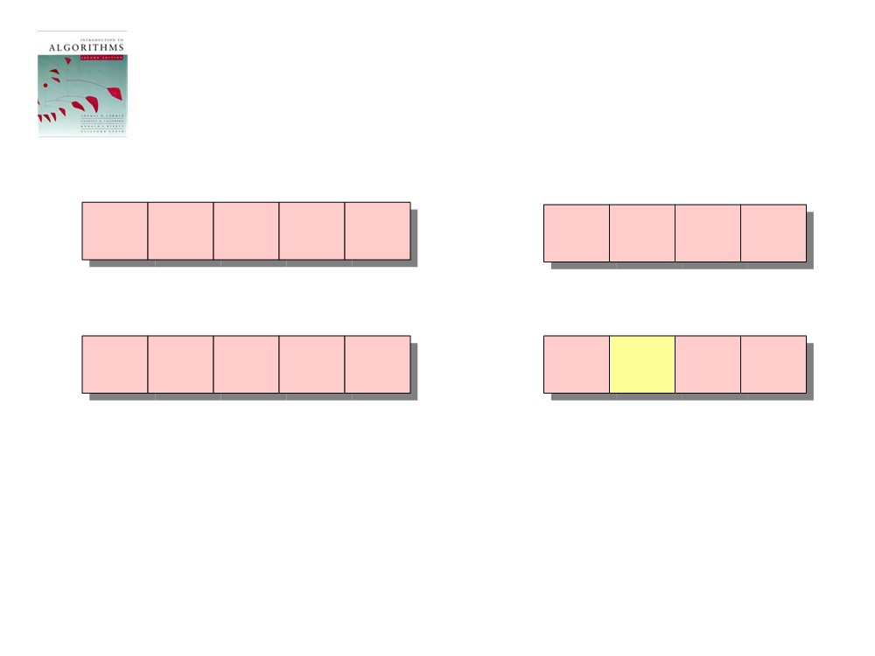
Loop 3
C is changed to hold
prefix sums
1
2
3
4
5
1
2
3
4
A:
4
1
3
4
3
C:
1
0
2
2
B:
C':
1
1
2
2
for i ← 2 to k
do C[i] ← C[i] + C[i-1]
// C[i] = |{key ≤ i}|

Slide 19
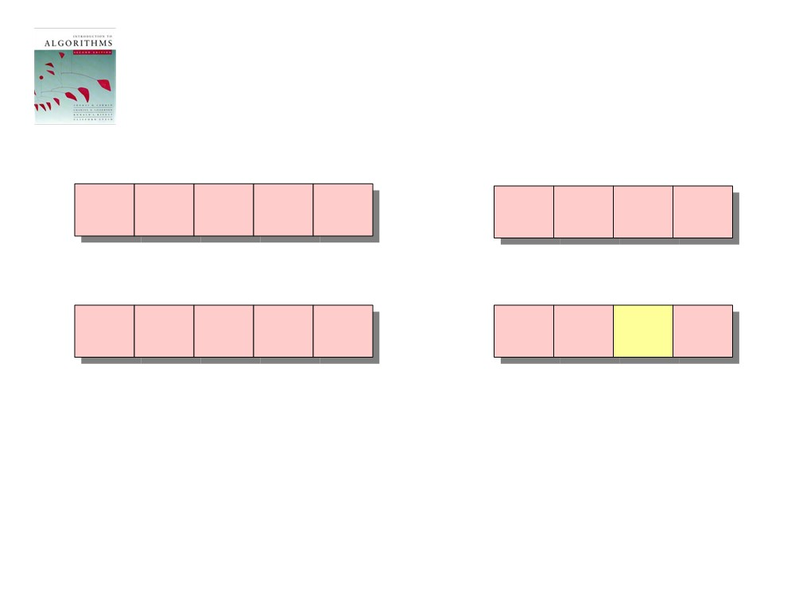
Loop 3
1
2
3
4
5
1
2
3
4
A:
4
1
3
4
3
C:
1
0
2
2
B:
C':
1
1
3
2
for i ← 2 to k
do C[i] ← C[i] + C[i-1]
// C[i] = |{key ≤ i}|

Slide 20
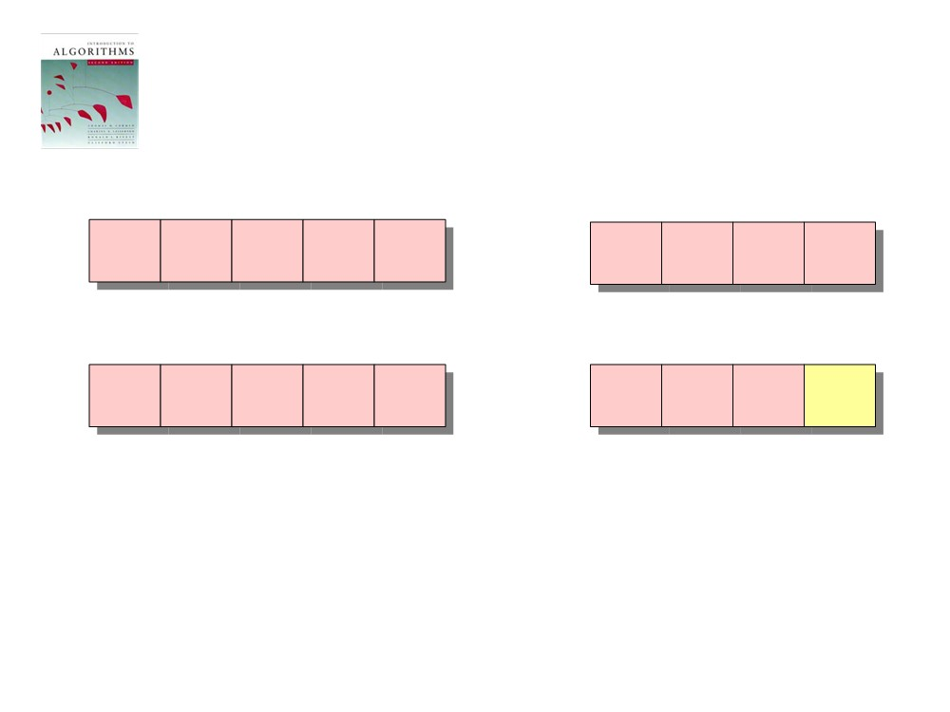
Loop 3
1
2
3
4
5
1
2
3
4
A:
4
1
3
4
3
C:
1
0
2
2
B:
C':
1
1
3
5
for i ← 2 to k
do C[i] ← C[i] + C[i-1]
// C[i] = |{key ≤ i}|

Slide 21
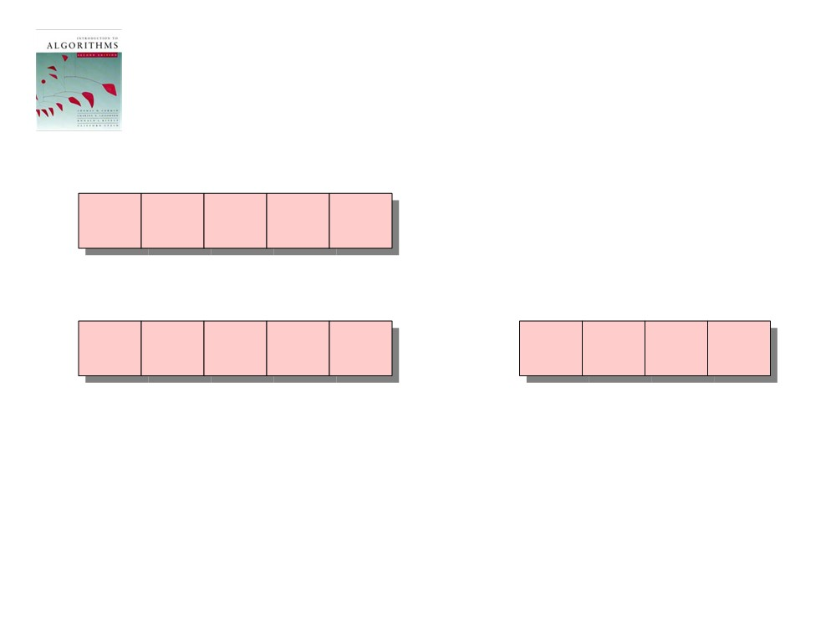
Loop 4
B is will store the A data
in its correct position
(distribution) based on C
1
2
3
4
5
A:
4
1
3
4
3
1
2
3
4
B:
C':
1
1
3
5
for j ← n downto 1
do B[C[A[ j]]] ← A[ j]
C[A[ j]] ← C[A[ j]] - 1

Slide 22
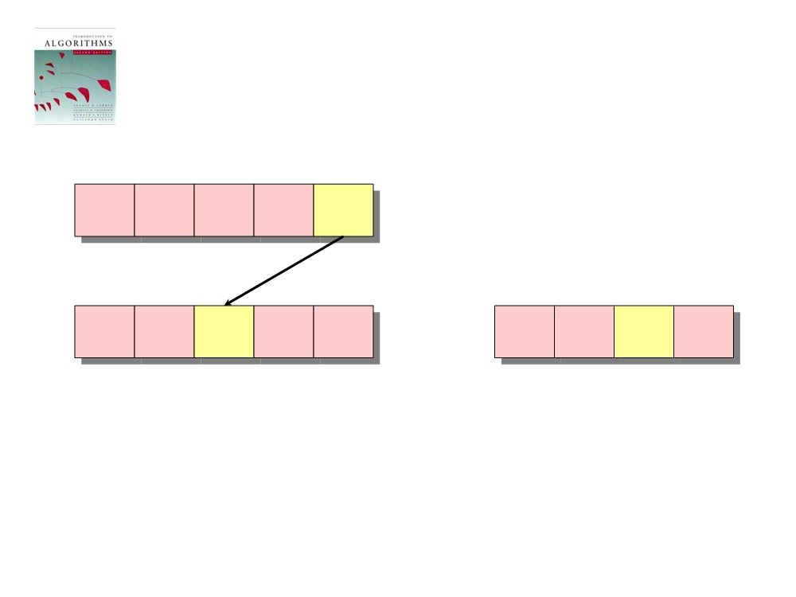
Loop 4
1
2
3
4
5
A:
4
1
3
4
3
1
2
3
4
B:
3
C':
1
1
3
5
for j ← n downto 1
do B[C[A[ j]]] ← A[ j]
C[A[ j]] ← C[A[ j]] - 1

Slide 23
Loop 4
1
2
3
4
5
A:
4
1
3
4
3
1
2
3
4
B:
3
C':
1
1
2
5
for j ← n downto 1
do B[C[A[ j]]] ← A[ j]
C[A[ j]] ← C[A[ j]] - 1
// decr counter

Slide 24
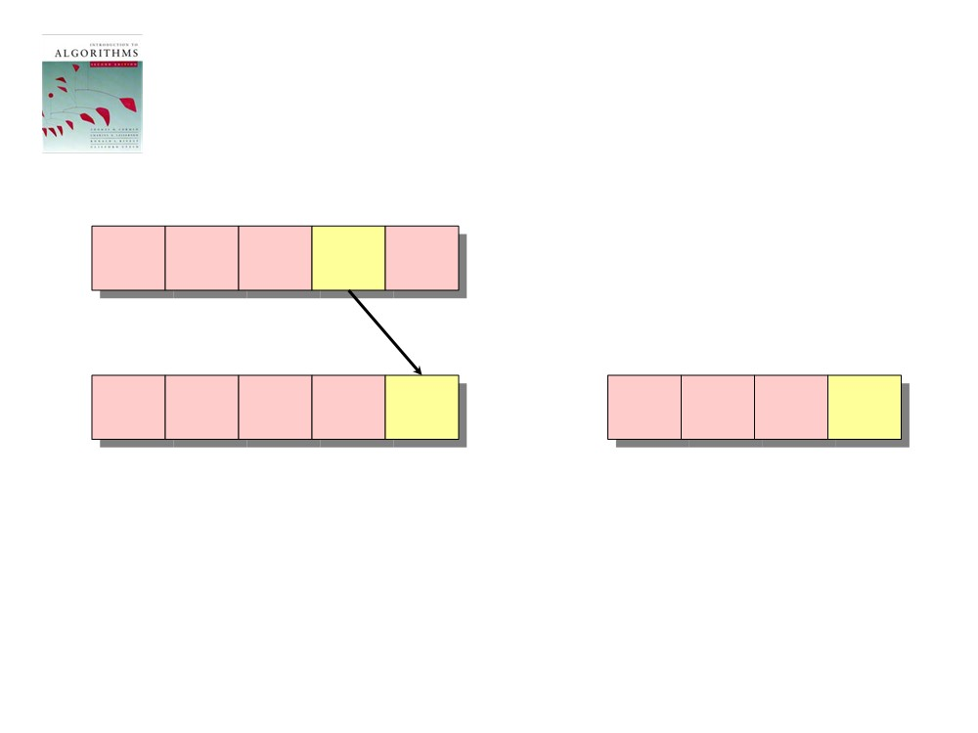
Loop 4
1
2
3
4
5
A:
4
1
3
4
3
1
2
3
4
B:
3
4
C':
1
1
2
5
for j ← n downto 1
do B[C[A[ j]]] ← A[ j]
C[A[ j]] ← C[A[ j]] - 1

Slide 25
Loop 4
1
2
3
4
5
A:
4
1
3
4
3
1
2
3
4
B:
3
4
C':
1
1
2
4
for j ← n downto 1
do B[C[A[ j]]] ← A[ j]
C[A[ j]] ← C[A[ j]] - 1
// decr counter

Slide 26
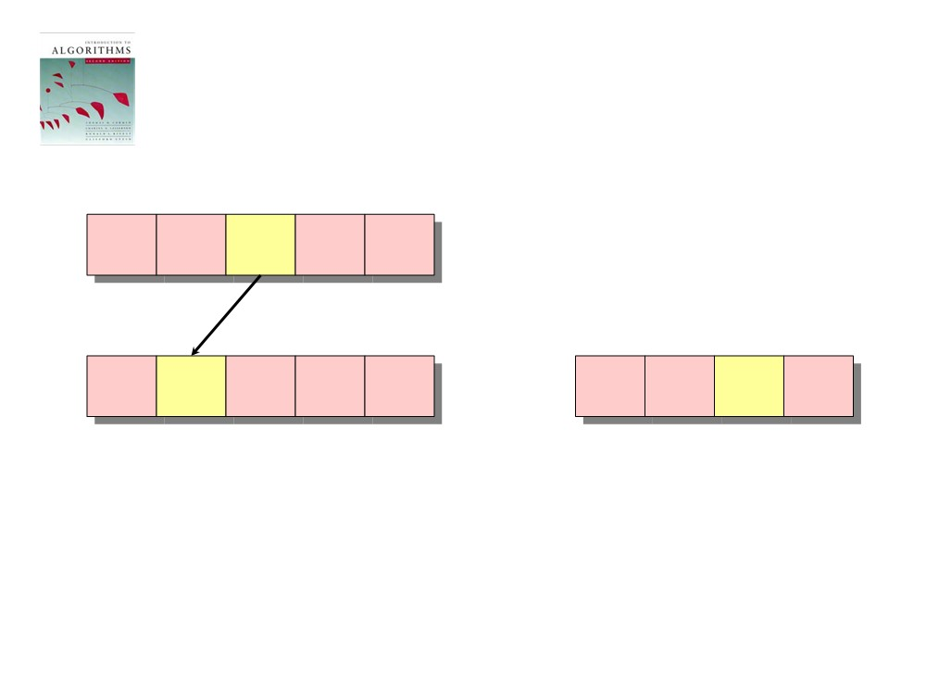
Loop 4
the decrement means
that this second 3
goes in the correct
position
1
2
3
4
5
A:
4
1
3
4
3
1
2
3
4
B:
3
3
4
C':
1
1
2
4
for j ← n downto 1
do B[C[A[ j]]] ← A[ j]
C[A[ j]] ← C[A[ j]] - 1

Slide 27
Loop 4
1
2
3
4
5
A:
4
1
3
4
3
1
2
3
4
B:
3
3
4
C':
1
1
1
4
for j ← n downto 1
do B[C[A[ j]]] ← A[ j]
C[A[ j]] ← C[A[ j]] - 1
// decr counter

Slide 28
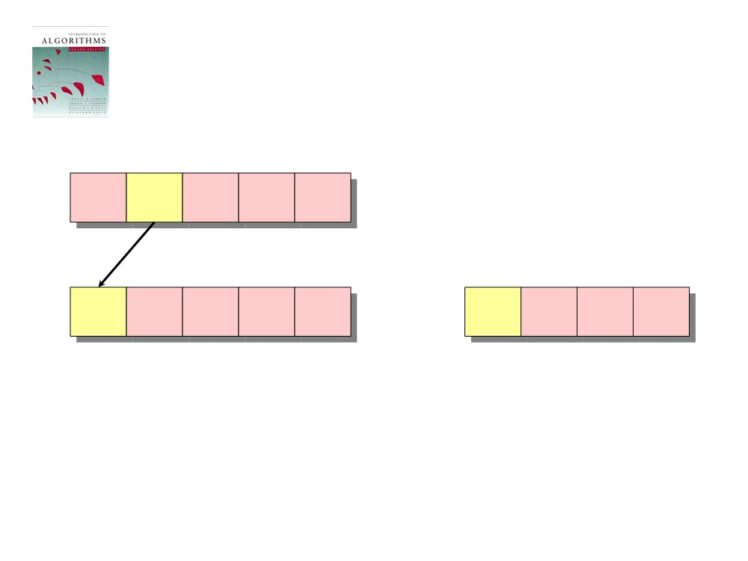
Loop 4
1
2
3
4
5
A:
4
1
3
4
3
1
2
3
4
B:
1
3
3
4
C':
1
1
1
4
for j ← n downto 1
do B[C[A[ j]]] ← A[ j]
C[A[ j]] ← C[A[ j]] - 1

Slide 29
Loop 4
1
2
3
4
5
A:
4
1
3
4
3
1
2
3
4
B:
1
3
3
4
C':
0
1
1
4
for j ← n downto 1
do B[C[A[ j]]] ← A[ j]
C[A[ j]] ← C[A[ j]] - 1
// decr counter

Slide 30
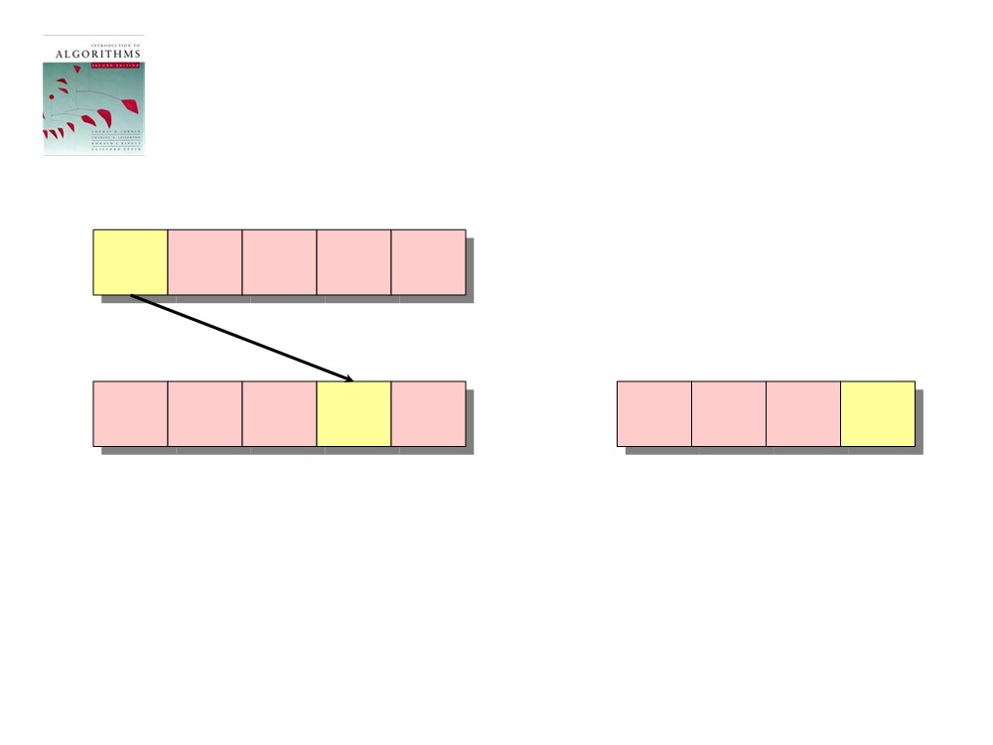
Loop 4
the decrement means
that this second 4
goes in the correct
position
1
2
3
4
5
A:
4
1
3
4
3
1
2
3
4
B:
1
3
3
4
4
C':
0
1
1
4
for j ← n downto 1
do B[C[A[ j]]] ← A[ j]
C[A[ j]] ← C[A[ j]] - 1

Slide 31
Loop 4
1
2
3
4
5
A:
4
1
3
4
3
1
2
3
4
B:
1
3
3
4
4
C':
0
1
1
3
for j ← n downto 1
do B[C[A[ j]]] ← A[ j]
C[A[ j]] ← C[A[ j]] - 1
// decr counter

Slide 32
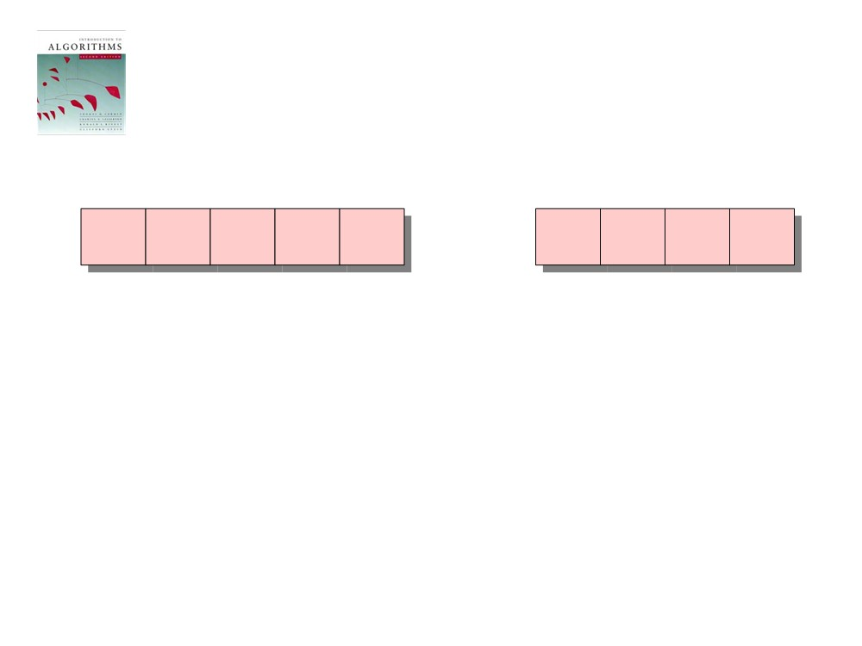
B vs C
1
2
3
4
5
1
2
3
4
B:
1
3
3
4
4
C':
1
1
3
5
In the end, each element i occupies the range
B[C[i-1]+1 … C[i]]

Slide 33
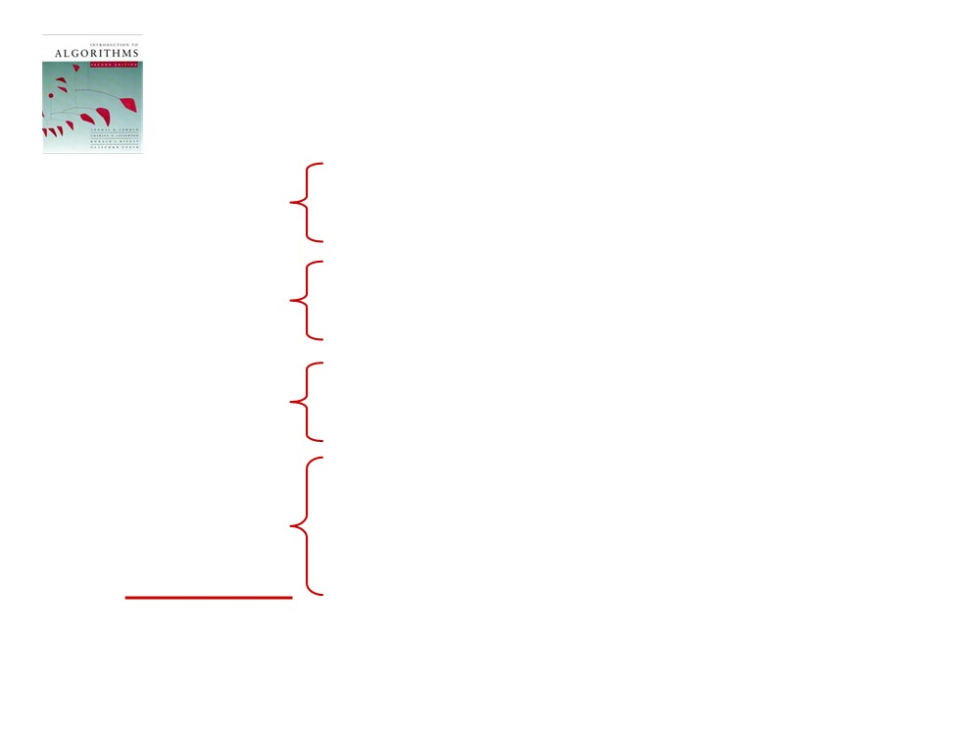
Analysis
O(k) O(n) O(k)
for i ← 1 to k do C[i] ← 0 for j ← 1 to n
do C[A[ j]] ← C[A[ j]] + 1 for i ← 2 to k
do C[i] ← C[i] + C[i-1] for j ← n downto 1
O(n) O(n + k)
do B[C[A[ j]]] ← A[ j] C[A[ j]] ← C[A[ j]] - 1

Slide 34
Running Time
Total time: O(n + k)
Usually, k = O(n)
Thus counting sort runs in O(n) time
Notice that this algorithm is stable
A sorting algorithm is said to be stable if two objects with equal keys appear in the same order in sorted output as they appear in the input array to be sorted

Slide 35
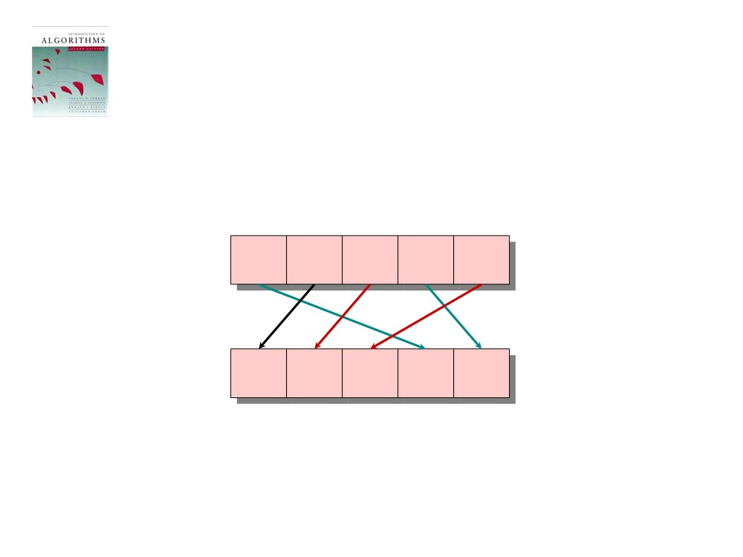
Stable Sorting
Counting sort is a stable sort: it preserves the input order among equal elements.
A:
4
1
3
4
3
B:
1
3
3
4
4

Slide 36
Drawbacks of Counting Sort
Why don’t we always use counting sort?
Because it depends on the range k of the elements
Could we use counting sort to sort 32 bit integers?
Yes, on x64 and enough ram memory having computers (2³² = 4,294,967,296)
k is used for the size of the C array = 4 GB

Slide 37
Radix Sort
Origin: Herman Hollerith’s card-sorting machine for the 1890 U.S. census
probably the oldest implemented sorted algorithm
uses punch cards
a digit-by-digit sort
Hollerith’s original (bad) idea: sort on the most-significant digit first
Problem: lots of intermediate piles of cards (i.e. extra temporary arrays) to keep track of the calculations

Slide 38
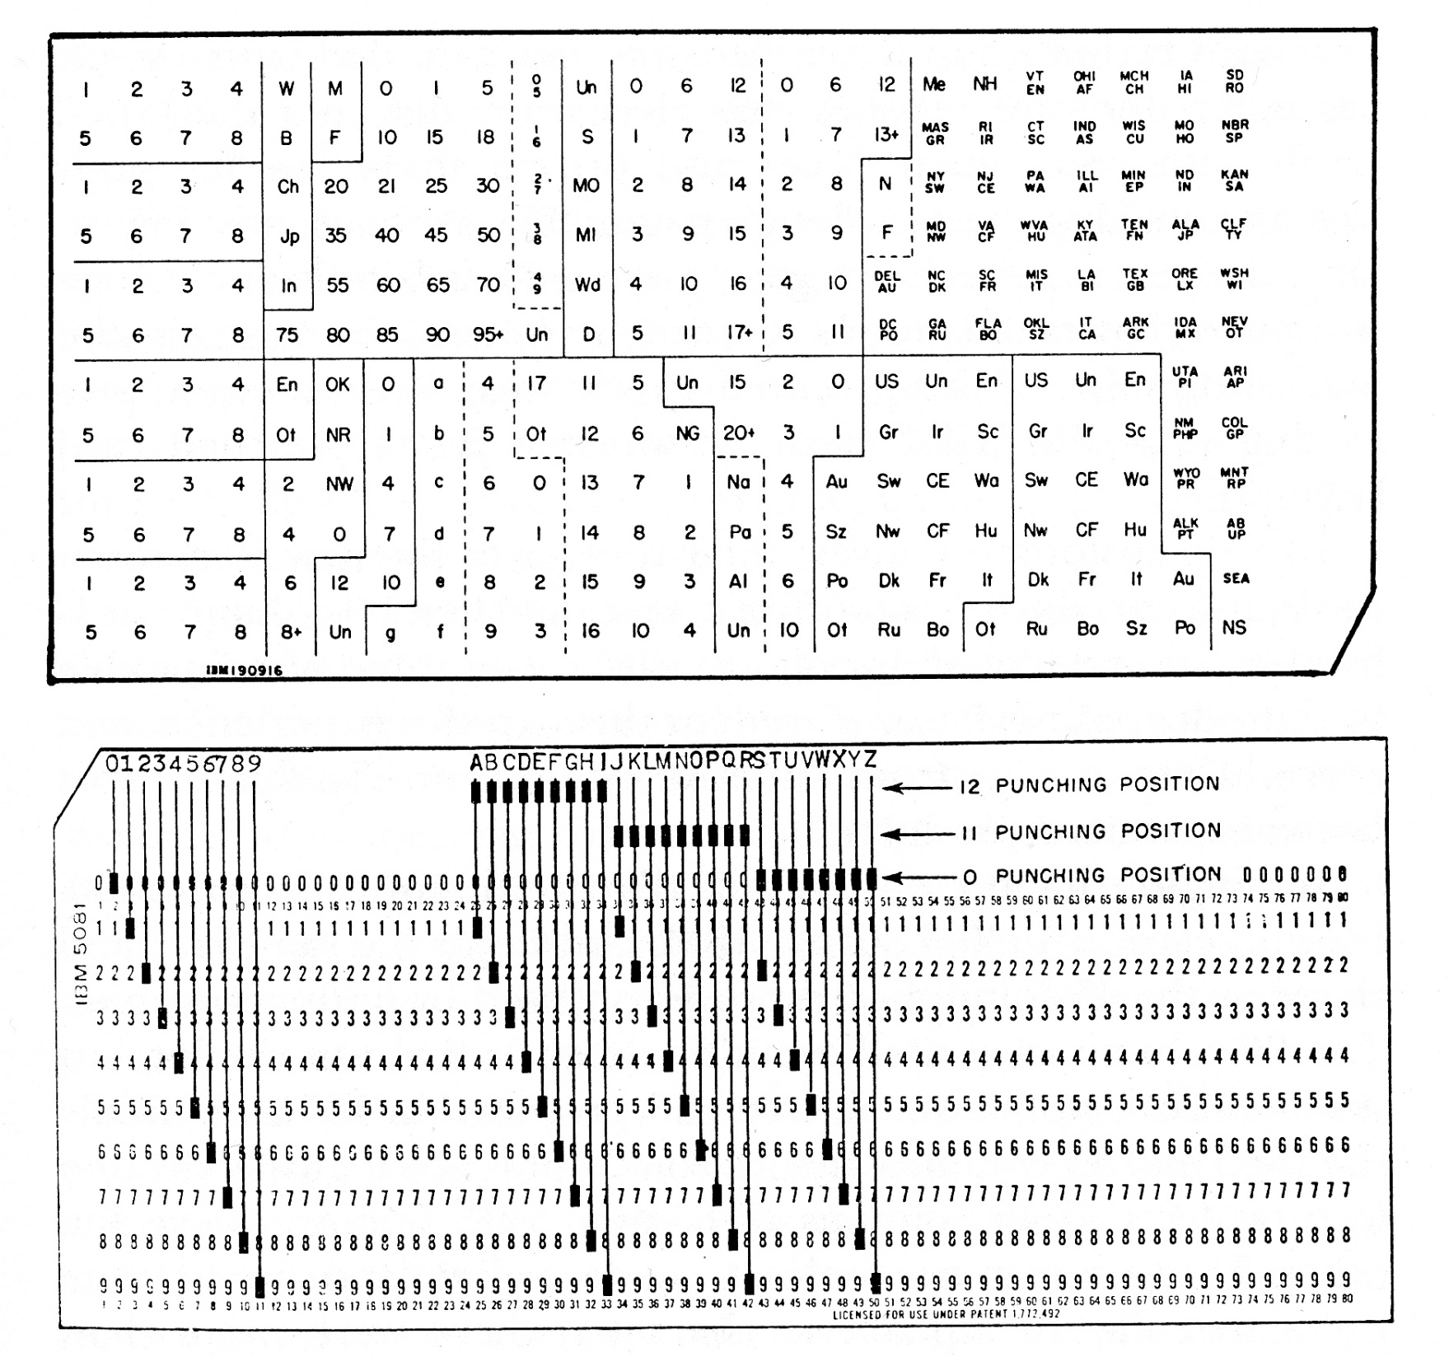

Slide 39
Good idea: sort on the least-significant digit first with a stable sort
preserves the relative order of equal elements
this is a property of counting sorts, as seen earlier
Code:
RadixSort(A, d){
for i = 1 to d
StableSort(A) on digit i }
this can be any sorting
algorithm, but must be stable

Slide 40
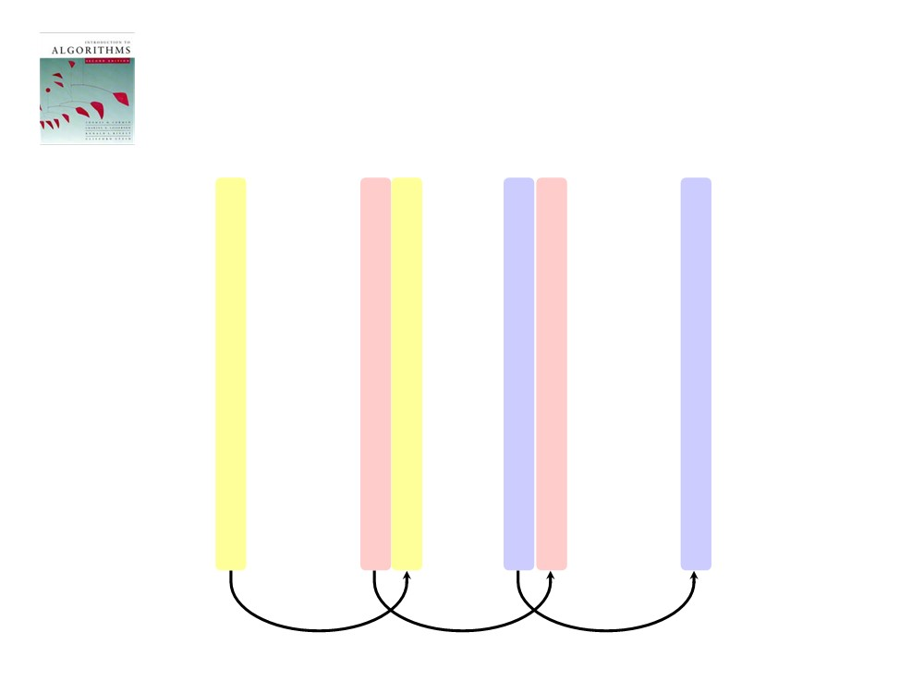
n = size of array = 7
k = range = 0..9 = 10
d = no. digits = 3
Operation of Radix Sort
d
3 2 9
7 2 0
7 2 0
3 2 9
4 5 7
3 5 5
3 2 9
3 5 5
6 5 7
4 3 6
4 3 6
4 3 6
n
8 3 9
4 5 7
8 3 9
4 5 7
4 3 6
6 5 7
3 5 5
6 5 7
7 2 0
3 2 9
4 5 7
7 2 0
k
3 5 5
8 3 9
6 5 7
8 3 9
notice stability
of 7's and 9's

Slide 41
Running Time
What StableSort() will we use to sort on digits?
Counting sort is a good choice:
Sort n numbers on digits that range from 0.. k
Time: O(n + k)
Each pass over n numbers with d digits takes time O(n+k), so total time O(dn + dk)
When d is constant and k = O(n), takes O(n) time

Slide 42
Radix Sort Speed
How do we sort 1 million 64-bit numbers?
Yes just d the number of digits thus the iteration count changes
Compares well with typical O(n log n) comparison sort
Requires approximately log n = 20 operations per number being sorted

Slide 43
Radix Sort Speed
In general, radix sort based on counting sort is
asymptotically fast (i.e., O(n))
simple to code
a good choice
To think about: can radix sort be used on floating-point numbers?
Yes it can be

Slide 44
Bucket Sort
Bucket-Sort(int[] A, int x, int y)
1. divide interval [x, y) into n equal-sized subintervals (buckets)
2. distribute the n input keys into the buckets
3. sort the numbers in each bucket (e.g., with insertion sort)
4. scan the (sorted) buckets in order and produce the output array (usually A)
Assumption: input elements are distributed uniformly over some known range, e.g., [0,1), so all the elements in A are greater than or equal to 0 but less than 1 .

Slide 45
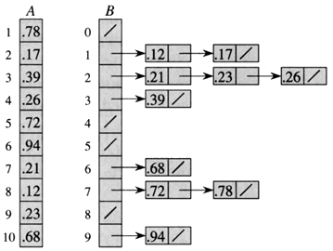
Bucket Sort Example
Sort A[] into the ten 'buckets' in B[], assuming the data in A is in [0..1)
each bucket
(list) must
be sorted
at the end, copy
the buckets (lists)
back into A[]

Slide 46
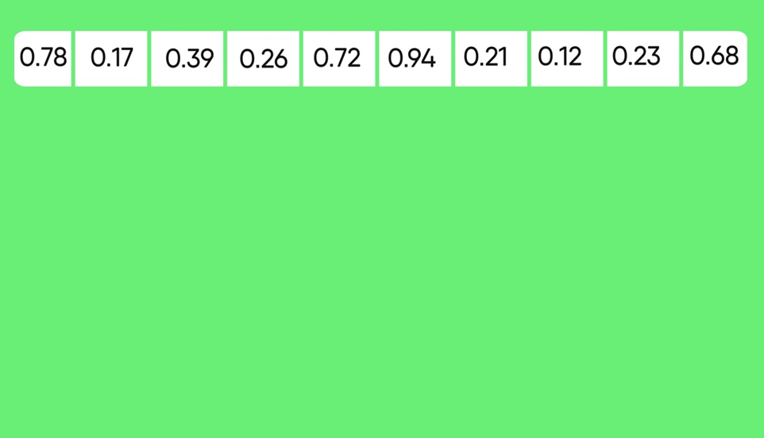

Slide 47
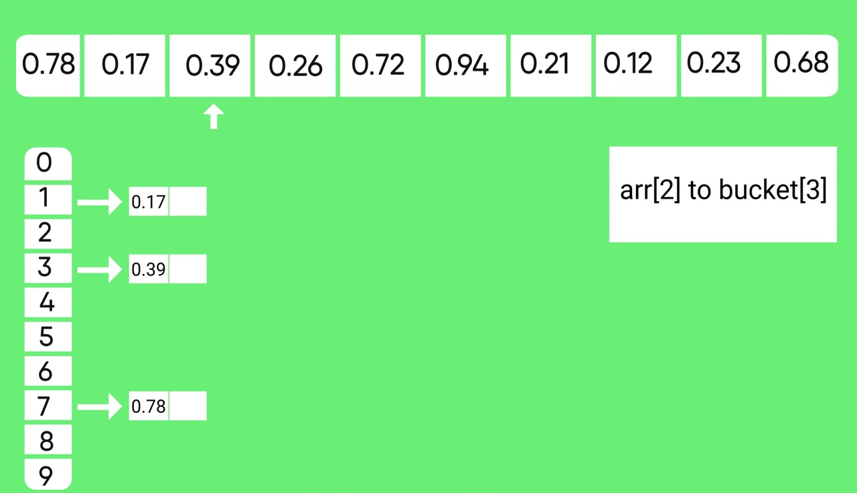

Slide 48
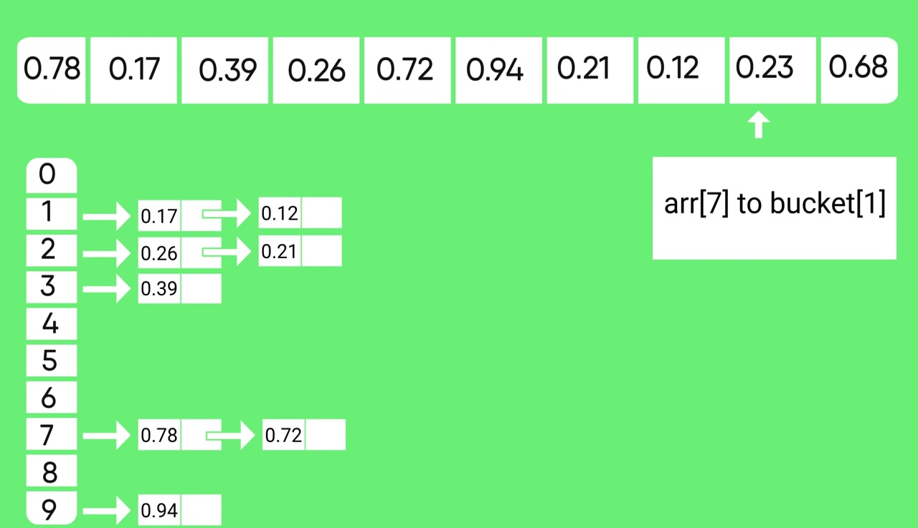

Slide 49
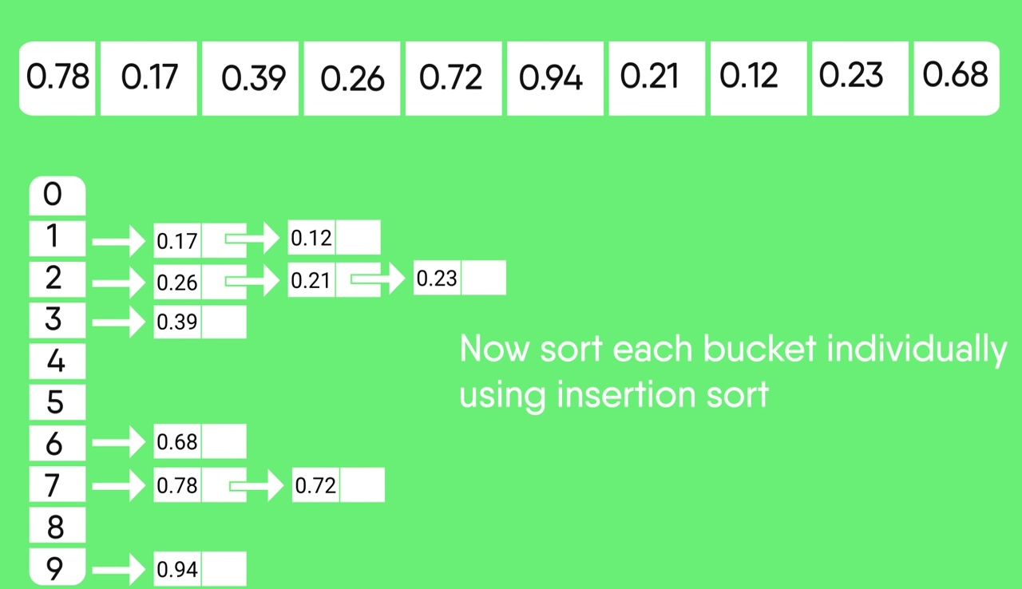

Slide 50


Slide 51
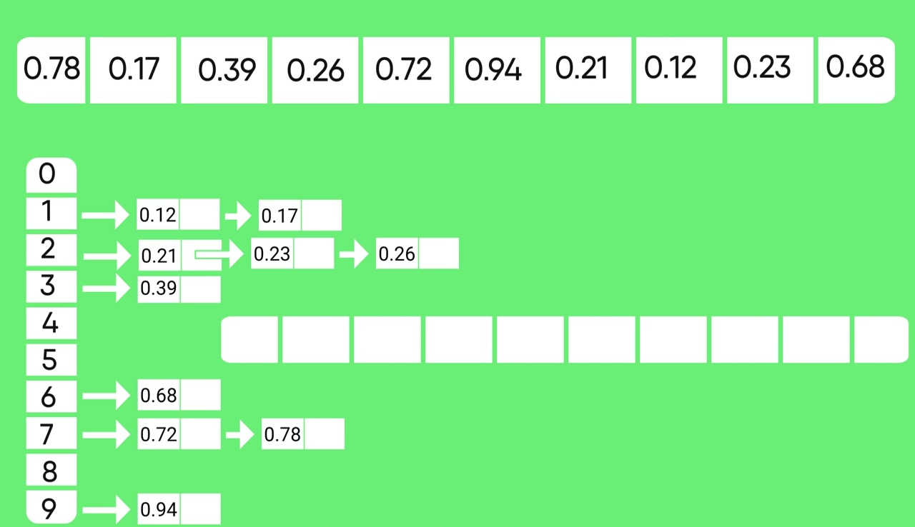

Slide 52
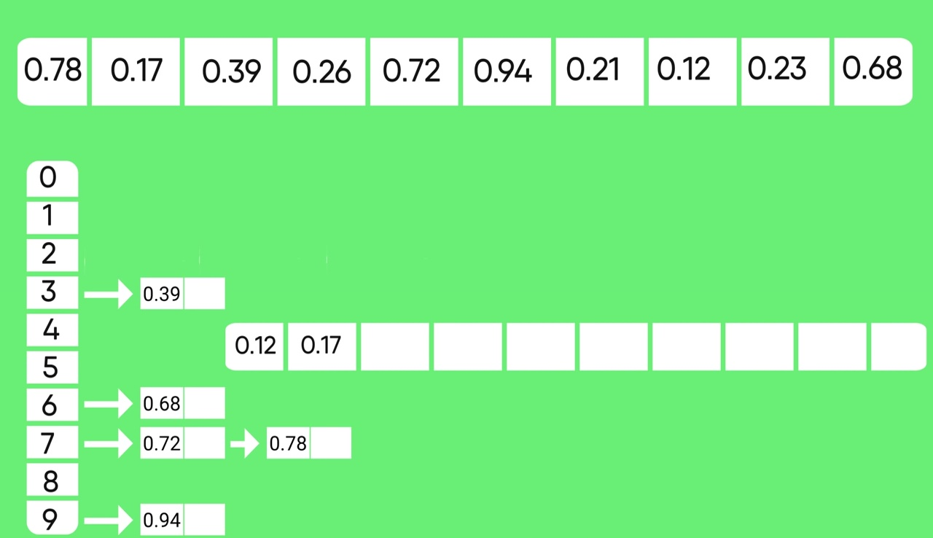

Slide 53
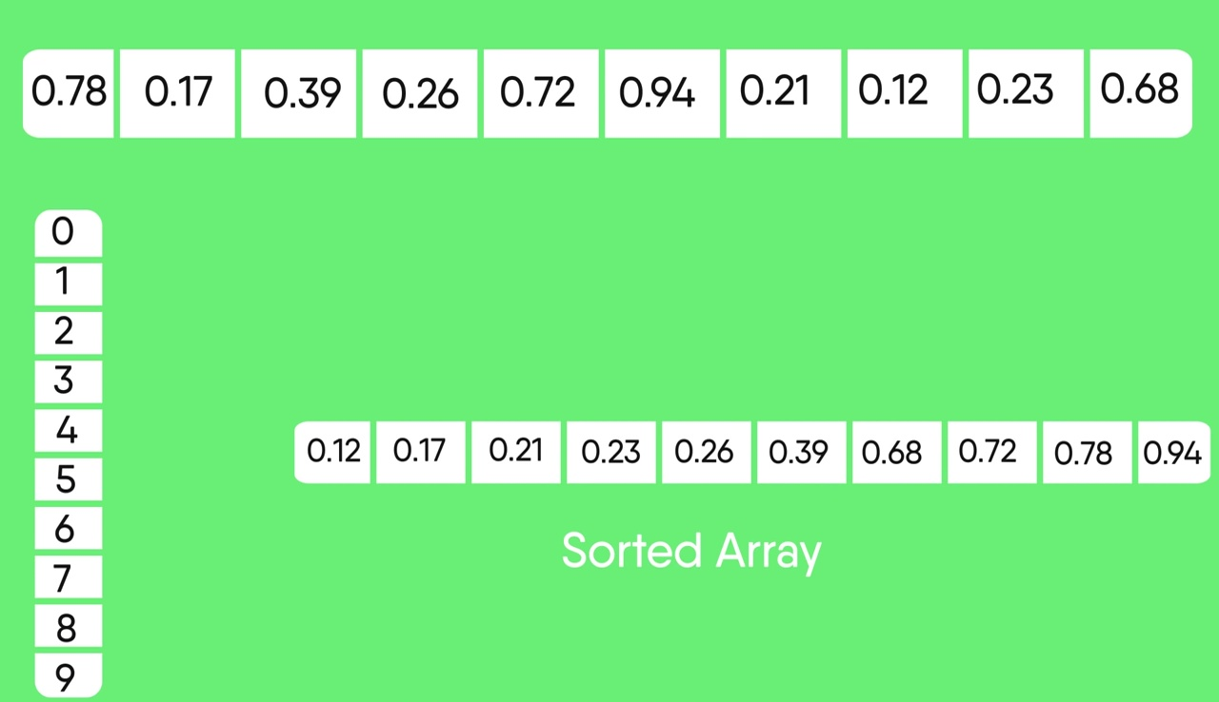

Slide 54
Bucket Sort Review
Pro’s:
Fast
asymptotically fast (i.e., O(n) when distribution is uniform)
simple to code
good for a rough sort
Con’s:
doesn’t sort in place

Slide 55
Why use Bucketsort and not Quicksort?
If we know k up front, and it is small (k << n) then bucket sort can efficiently run faster than Quicksort, since n*log(n), the average for Quicksort, will be more than (n + k), which is the average for bucket sort.
I.e., sortedList = (n*log(n) > n + k) ? bucketSort(list) : quicksort(list);
For example, bucketsort may be preferred for streams over quicksort because the max char to be ordered compared to the minimum value can be as small as the ASCII value of 0 to the ASCII value of z, hence reducing K to a number around 60

Slide 56
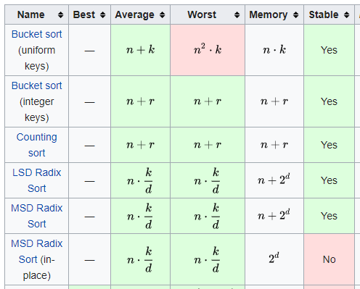
Summary of Linear Sorts Non-Comparison Sorts
https://en.wikipedia.org/wiki/Sorting_algorithm

